Slide 1
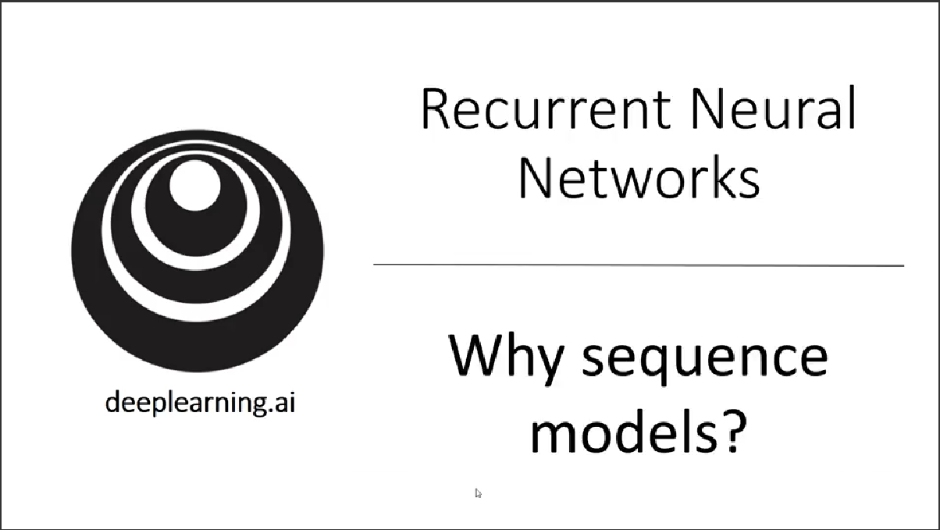

Slide 2
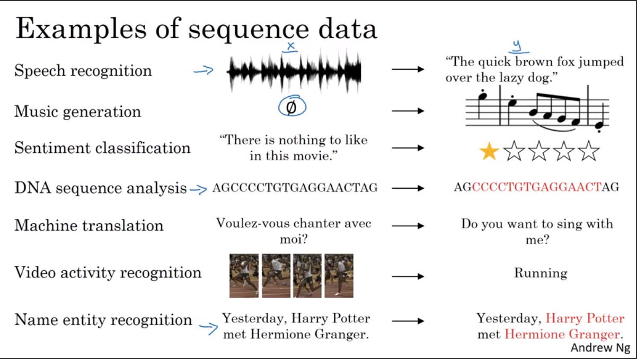

Slide 3
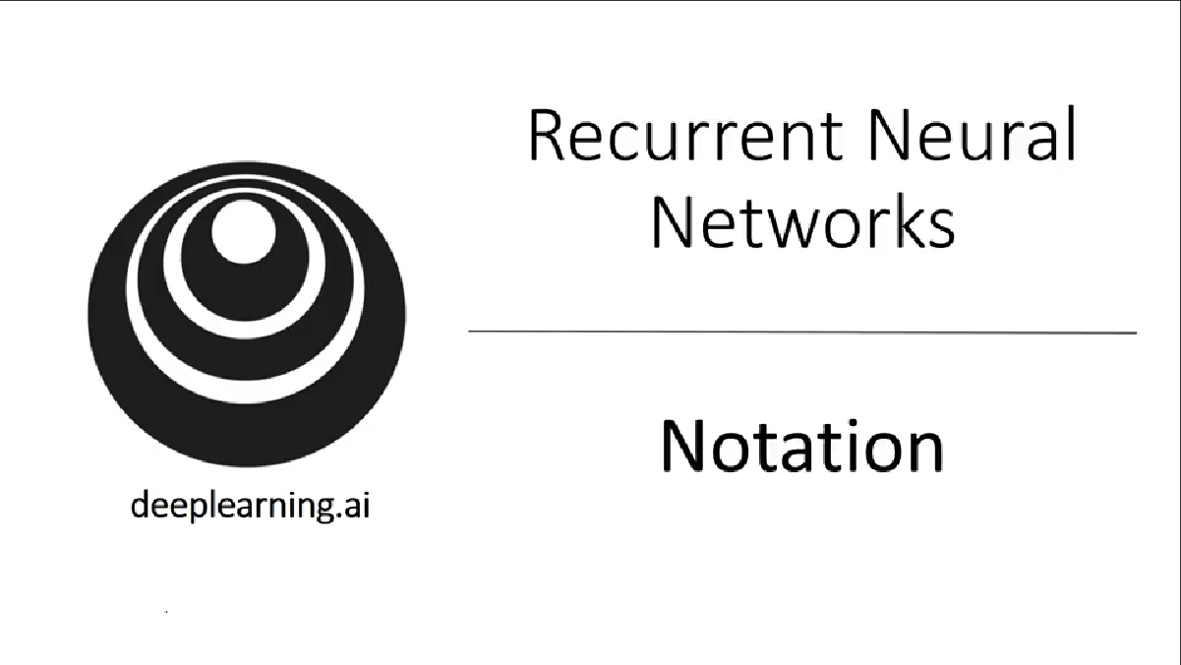

Slide 4
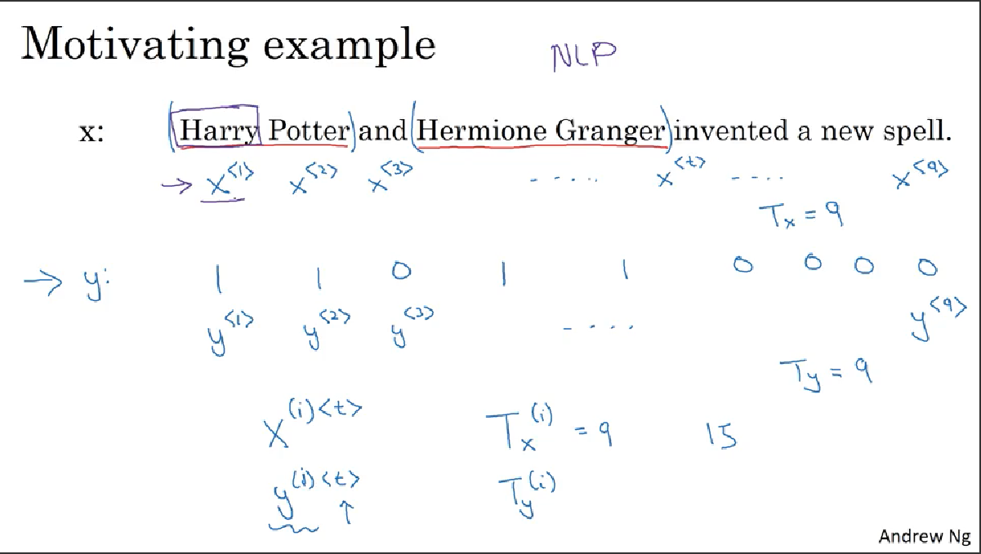

Slide 5
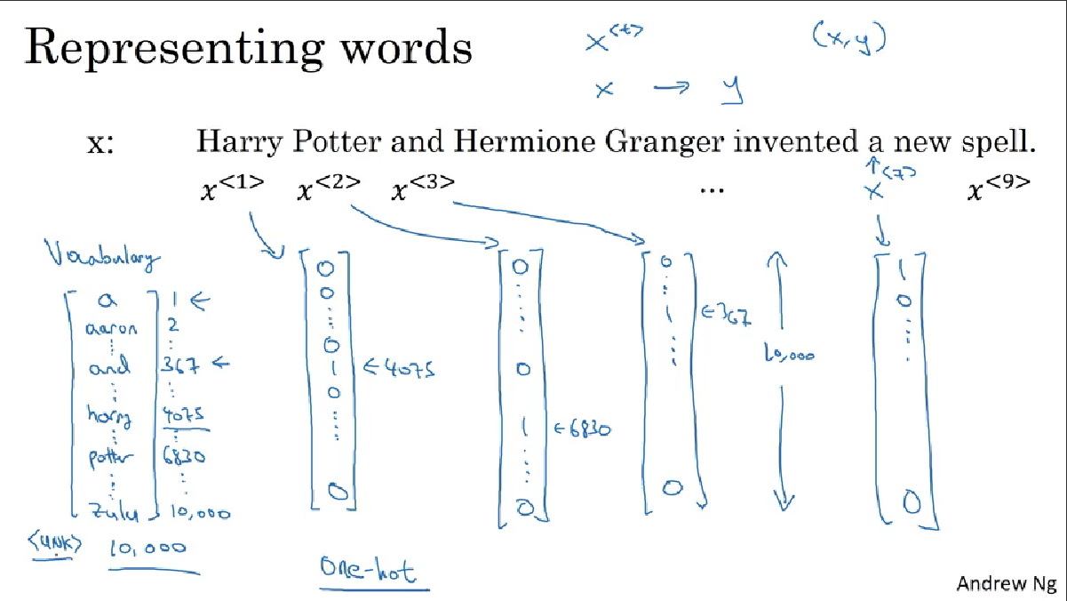

Slide 6
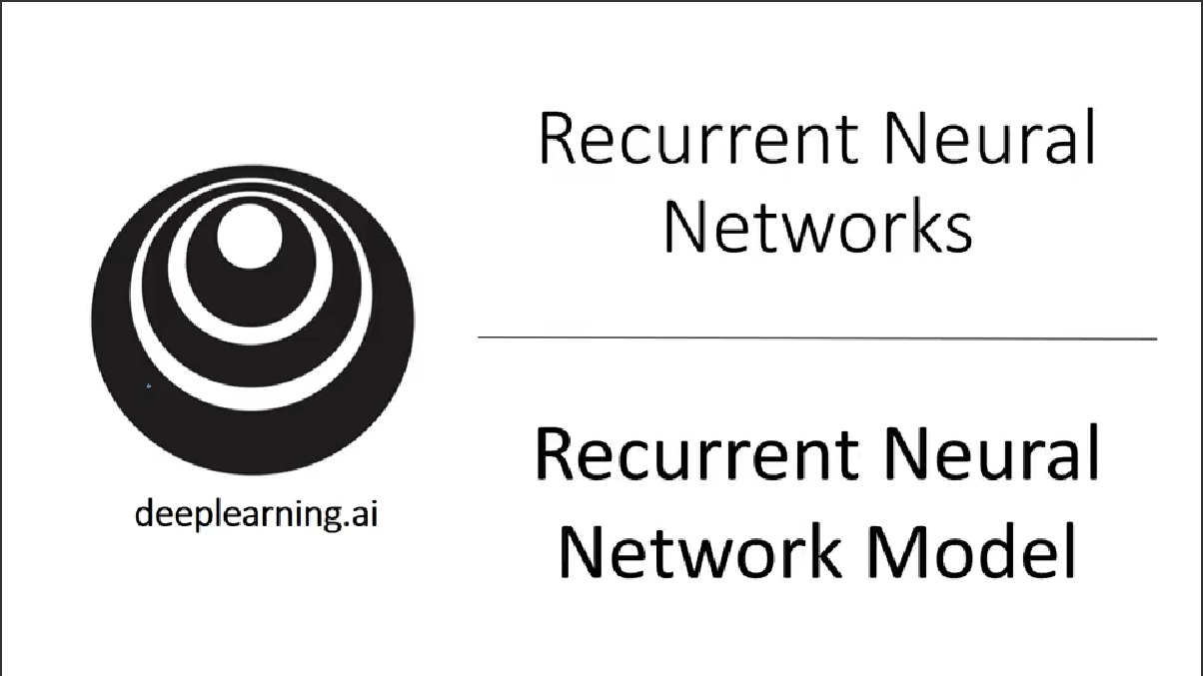

Slide 7
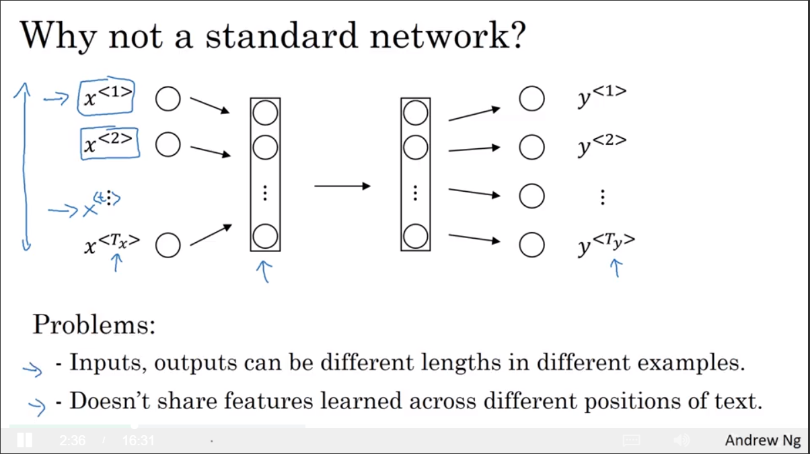

Slide 8
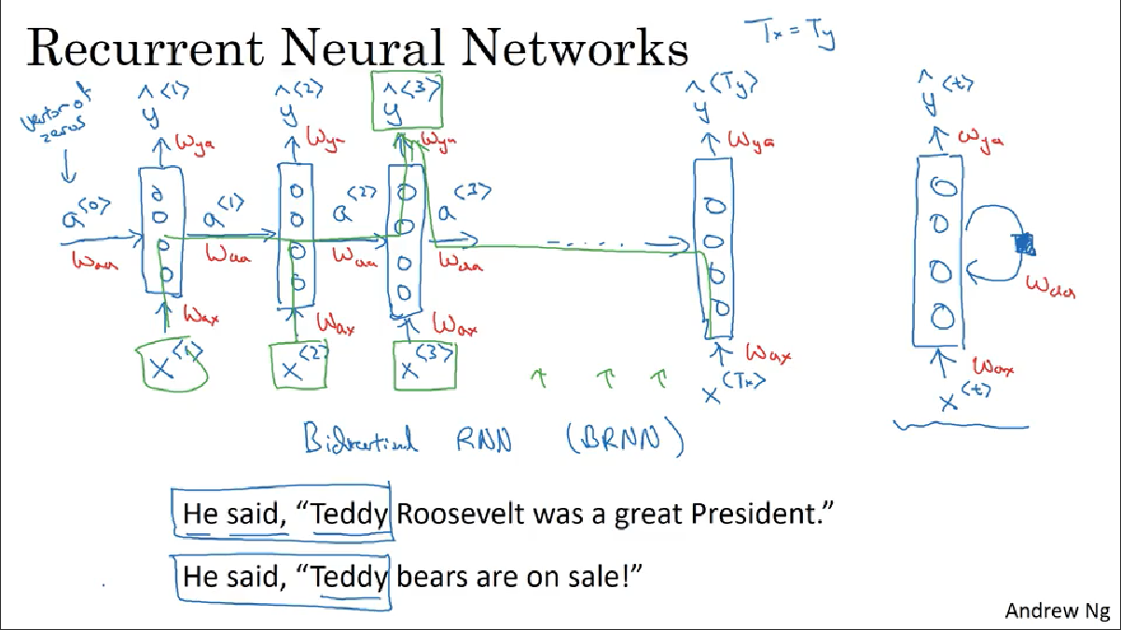

Slide 9
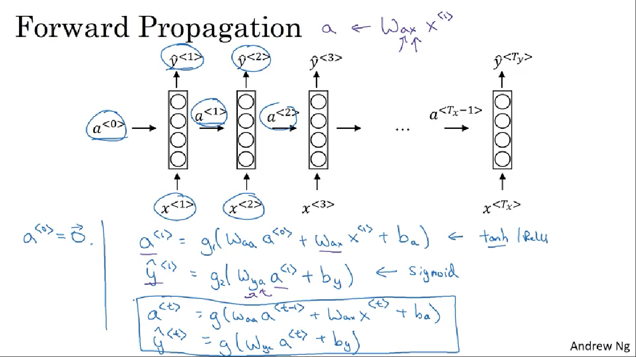

Slide 10
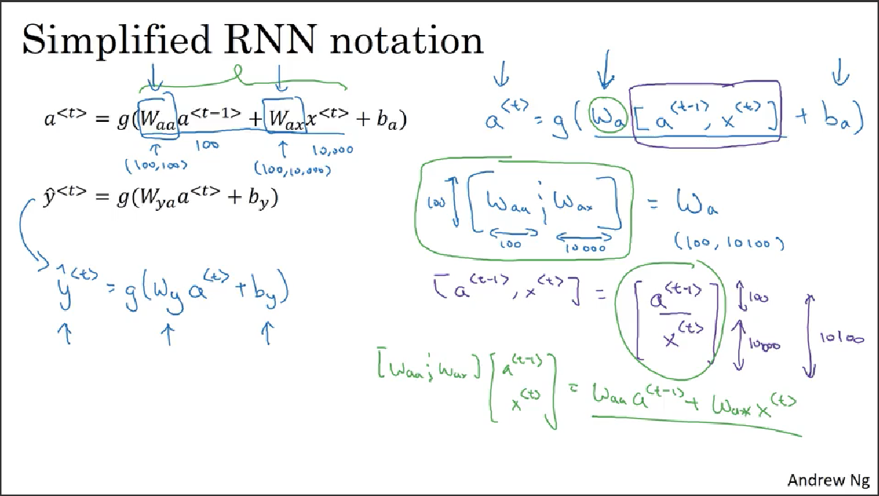

Slide 11
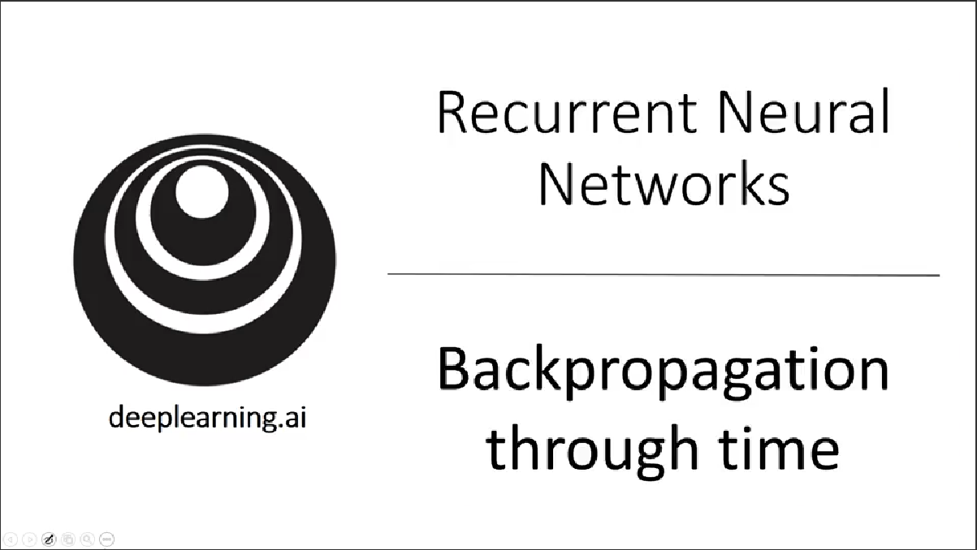

Slide 12
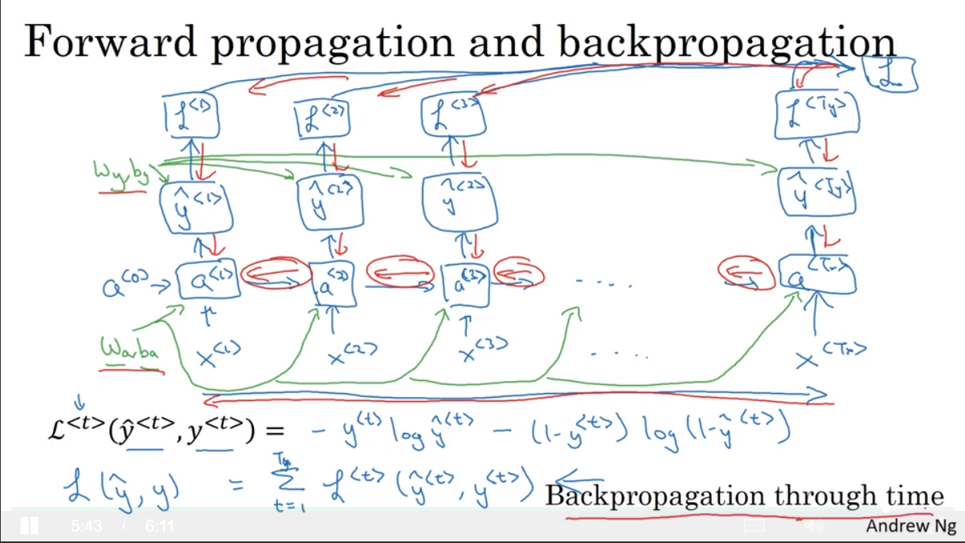

Slide 13
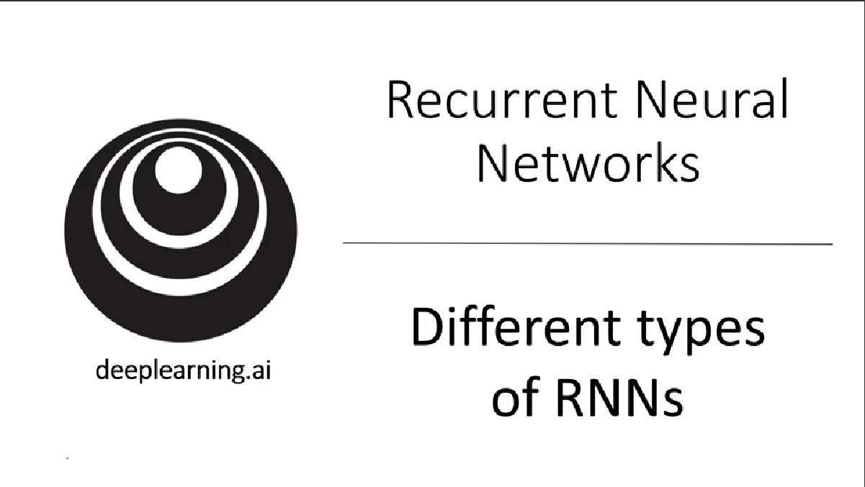

Slide 14
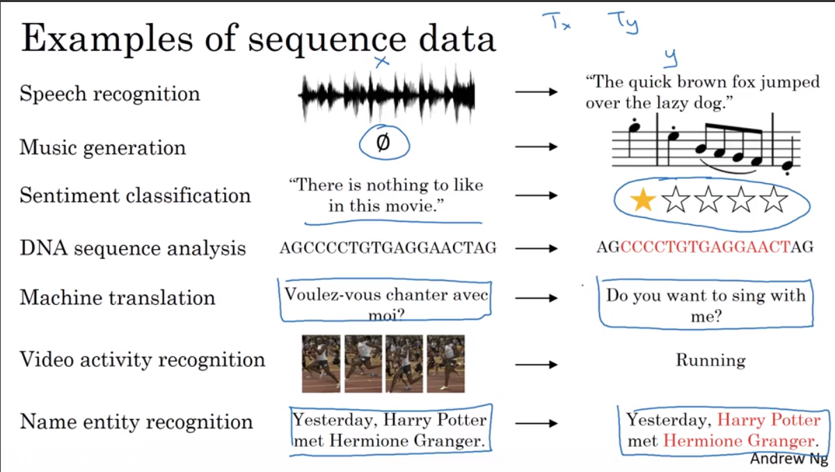

Slide 15
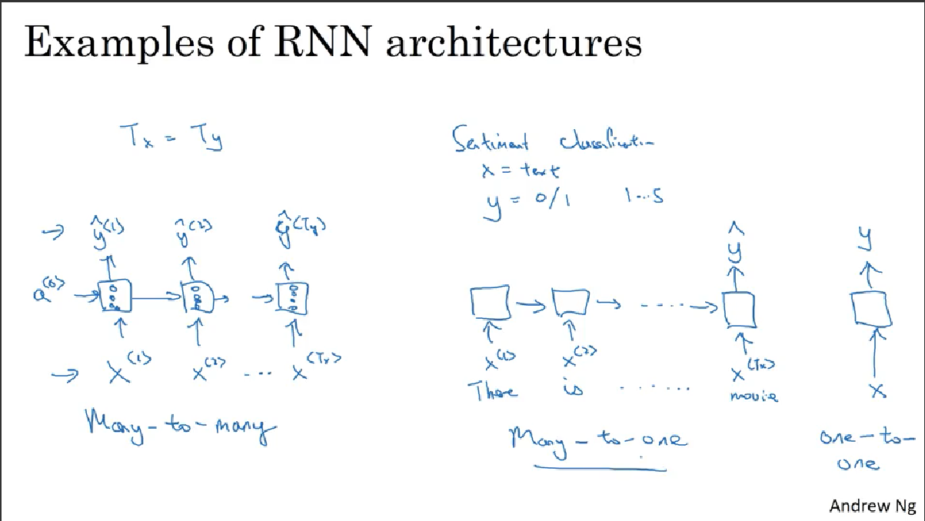

Slide 16
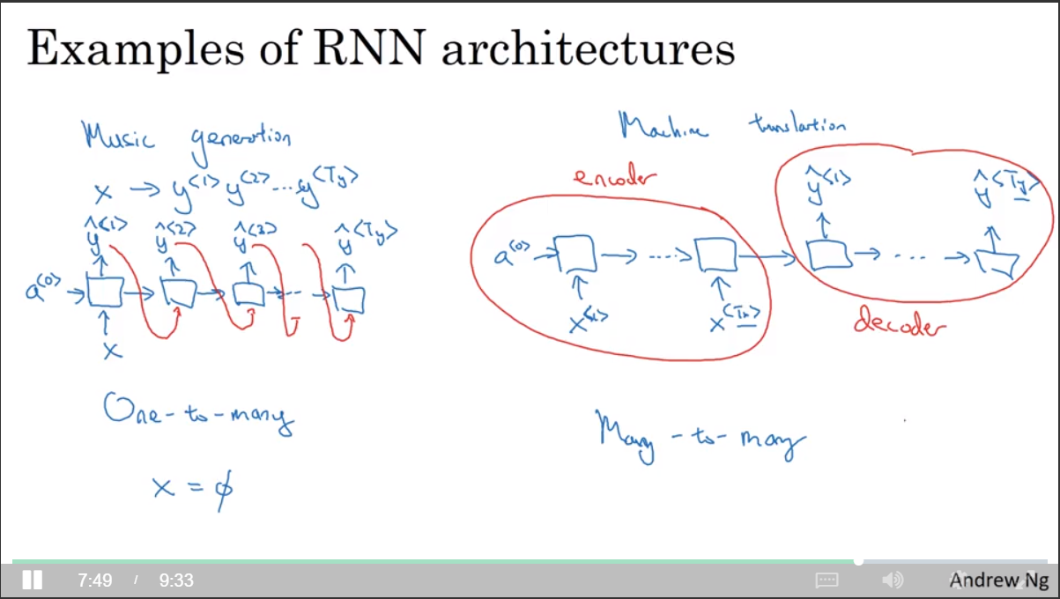

Slide 17
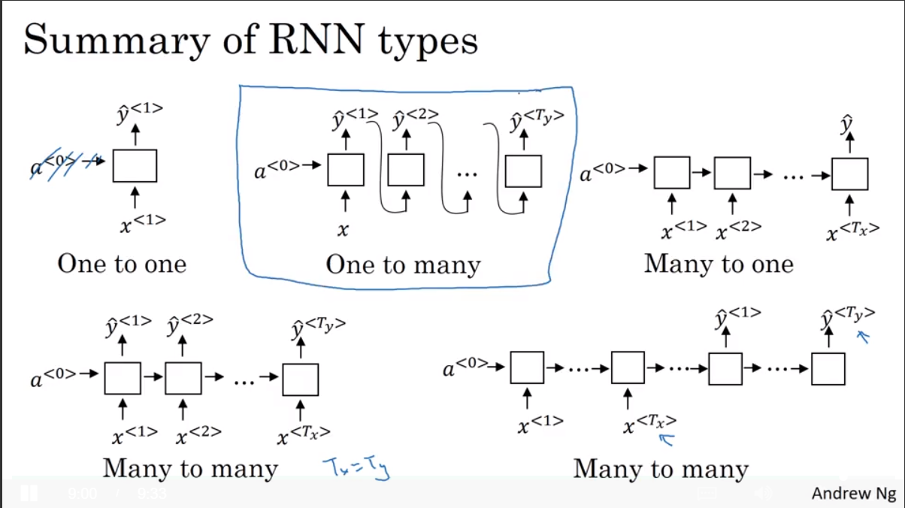

Slide 18
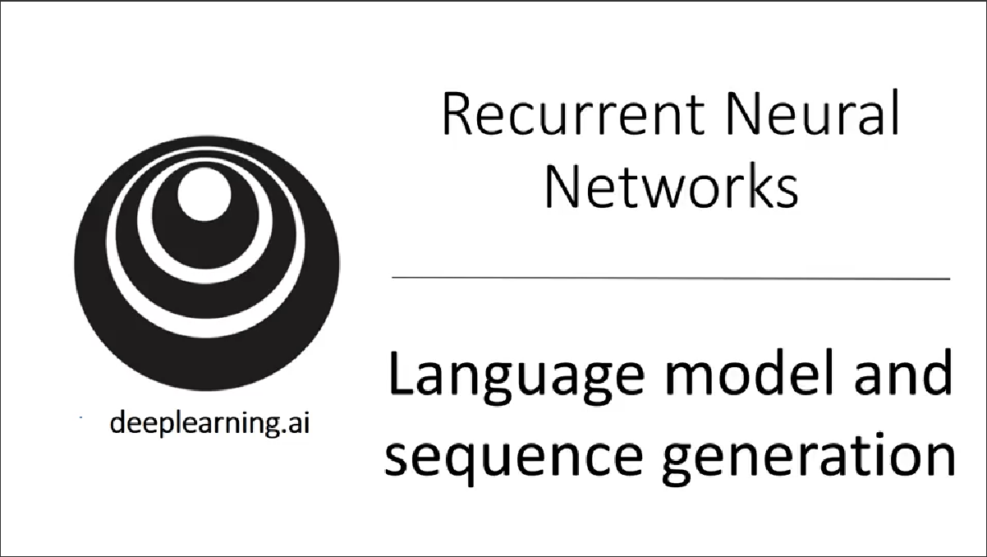

Slide 19
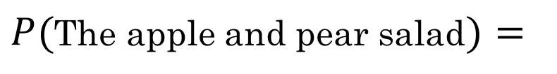
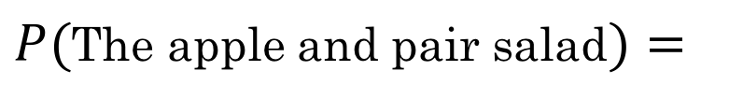
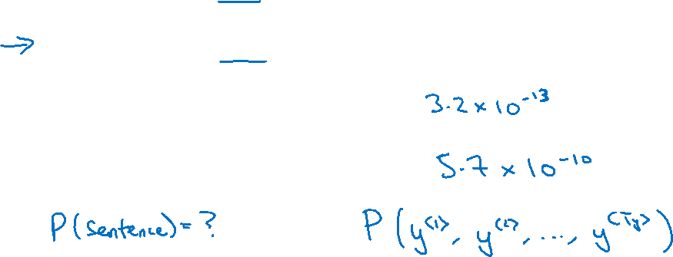
What is language modelling?
Speech recognition
The apple and pair salad.
The apple and pear salad.
$P($The apple and pair salad$)=$
$P($The apple and pear salad$)=$

Slide 20
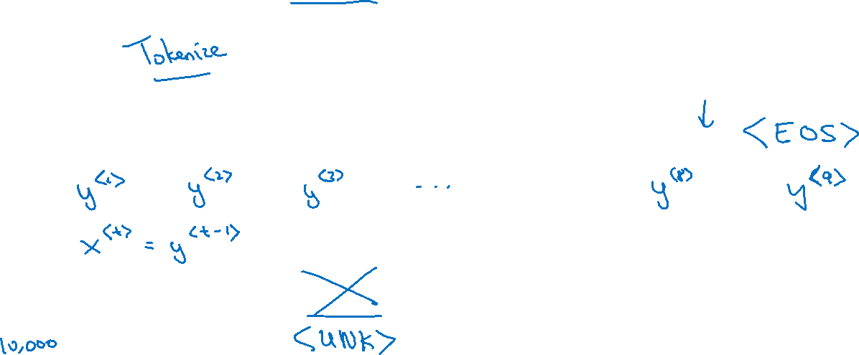
Language modelling with an RNN
Training set: large corpus of english text.
Cats average 15 hours of sleep a day.
The Egyptian Mau is a bread of cat. <EOS>

Slide 21
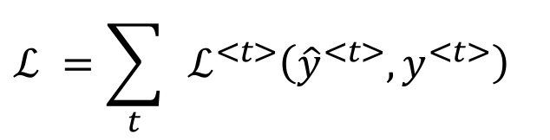
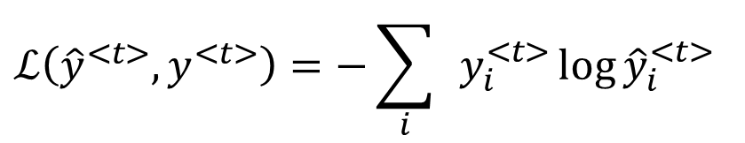
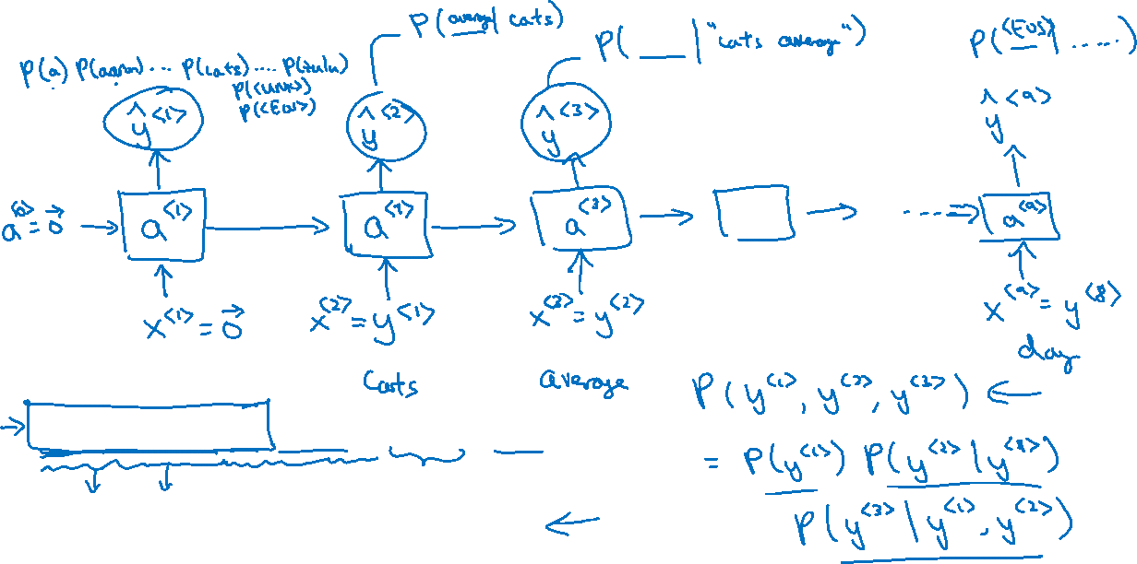
RNN model
Cats average 15 hours of sleep a day. <EOS>
$$ℒ\left({\hat{y}}^{<t>},y^{<t>}\right)=−\sum_{i}{ }y_{i}^{<t>}{\log{\hat{y}}}_{i}^{<t>}$$
$$ℒ^{ }=\sum_{t}{ }ℒ^{<t>}\left({\hat{y}}^{<t>},y^{<t>}\right)$$

Slide 22

Recurrent Neural Networks
Sampling novel sequences
deeplearning.ai

Slide 23
Sampling a sequence from a trained RNN
$${\hat{y}}^{<1> }$$
$${\hat{y}}^{<2> }$$
$${\hat{y}}^{<3> }$$
$${\hat{y}}^{<T_{y}> }$$
$$a^{<0>}$$
$$a^{<1>}$$
$$a^{<2>}$$
$$a^{<3>}$$
$$⋯$$
$$a^{<T_{y}>}$$
$$x^{<1>}$$
$$y^{<1>}$$
$$y^{<2>}$$
$$y^{<T_{x}−1>}$$

Slide 24
Character-level language model
Vocabulary = [a, aaron, …, zulu, <UNK>]
$${\hat{y}}^{<1> }$$
$${\hat{y}}^{<2> }$$
$${\hat{y}}^{<3> }$$
$${\hat{y}}^{<T_{y}> }$$
$$a^{<0>}$$
$$a^{<1>}$$
$$a^{<2>}$$
$$a^{<3>}$$
$$⋯$$
$$a^{<T_{y}>}$$
$$x^{<1>}$$
$${\hat{y}}^{<1> }$$
$${\hat{y}}^{<2> }$$
$${\hat{y}}^{<T_{x}−1> }$$

Slide 25
Sequence generation
News
Shakespeare
President enrique peña nieto, announced sench’s sulk former coming football langston paring.
“I was not at all surprised,” said hich langston.
“Concussion epidemic”, to be examined.
The gray football the told some and this has on the uefa icon, should money as.
The mortal moon hath her eclipse in love.
And subject of this thou art another this fold.
When besser be my love to me see sabl’s.
For whose are ruse of mine eyes heaves.

Slide 26
Recurrent Neural Networks
Vanishing gradients with RNNs
deeplearning.ai

Slide 27
Vanishing gradients with RNNs
$${\hat{y}}^{<1> }$$
$${\hat{y}}^{<2> }$$
$${\hat{y}}^{<3> }$$
$${\hat{y}}^{<T_{y}> }$$
$$a^{<0>}$$
$$a^{<1>}$$
$$a^{<2>}$$
$$a^{<3>}$$
$$⋯$$
$$a^{<T_{y}>}$$
$$x^{<1>}$$
$$x^{<2>}$$
$$x^{<3>}$$
$$x^{<T_{x}>}$$
$$x^{ }$$
$$⋯$$
$${\hat{y}}^{ }$$
$$⋮$$
$$⋮$$
$$⋮$$
$$⋮$$
$$⋮$$
$$⋮$$
$$⋮$$
Exploding gradients.

Slide 28
Recurrent Neural Networks
Gated Recurrent Unit (GRU)
deeplearning.ai

Slide 29
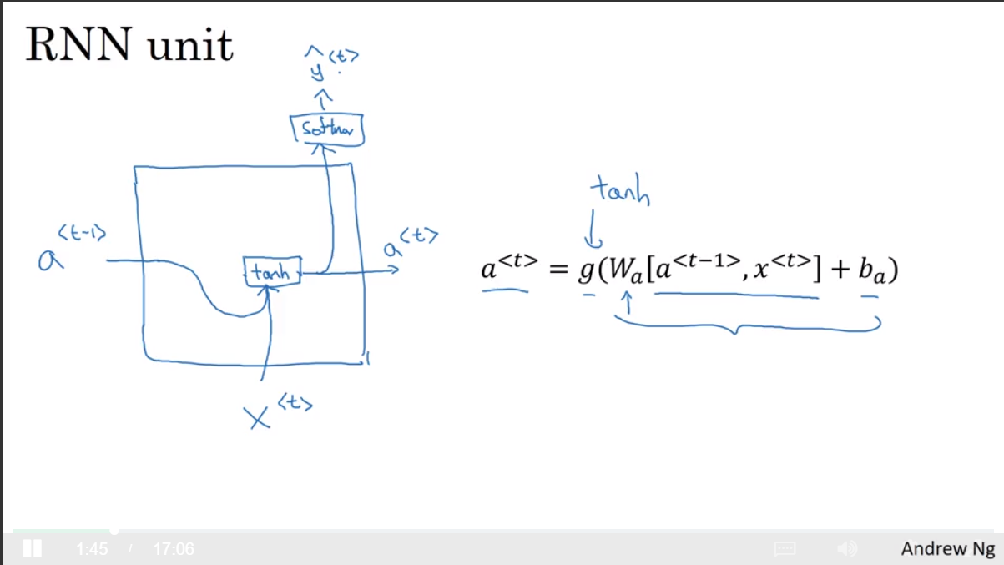

Slide 30
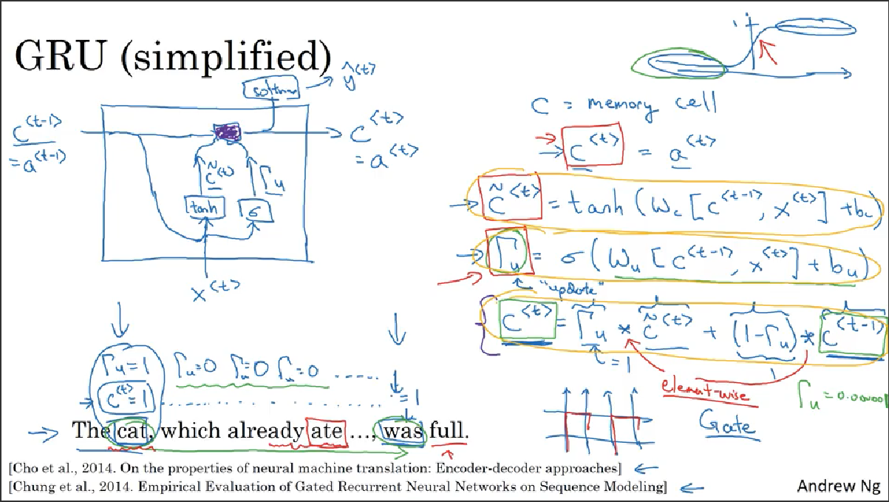

Slide 31
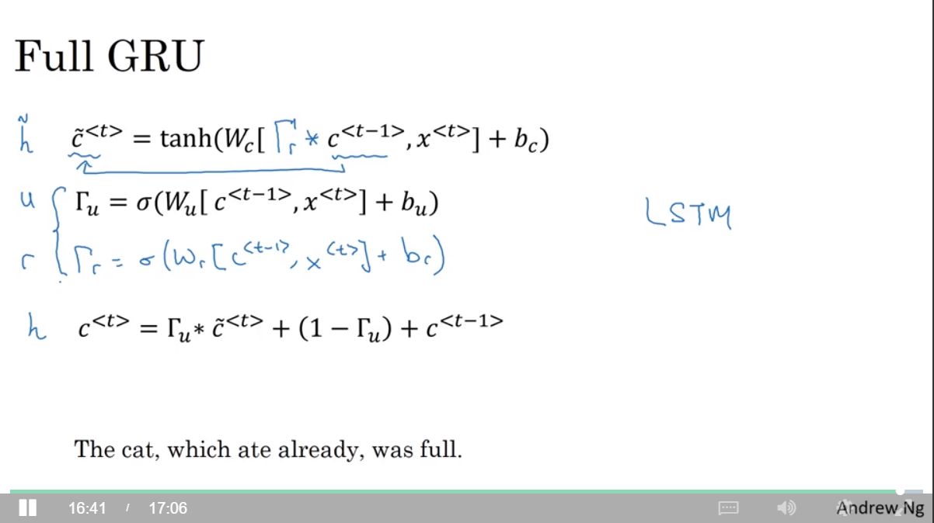

Slide 32
Recurrent Neural Networks
LSTM (long short term memory) unit
deeplearning.ai

Slide 33
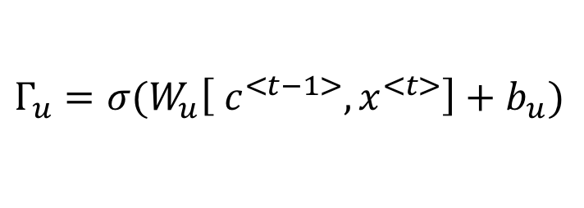
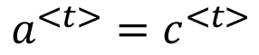
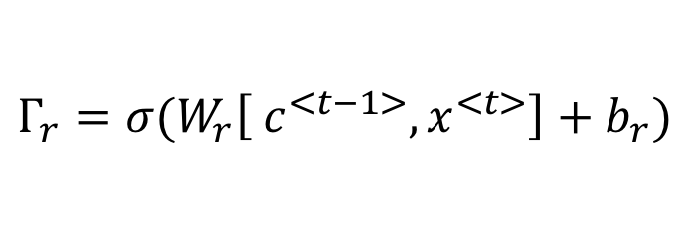
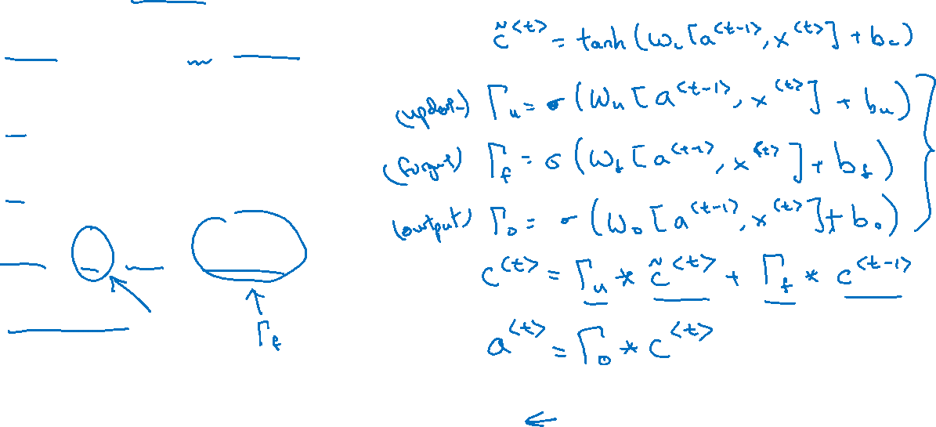
GRU and LSTM
GRU
LSTM
$${\tilde{c}}^{<t>}=\tanh{(W_{c}\left[Γ_{r}∗c^{<t−1>},x^{<t>}\right]+b_{c})}$$
$$Γ_{u}=σ{(W_{u}\left[ c^{<t−1>},x^{<t>}\right]+b_{u})}$$
$$Γ_{r}=σ{(W_{r}\left[ c^{<t−1>},x^{<t>}\right]+b_{r})}$$
$$c^{<t>}=Γ_{u}{∗{\tilde{c}}^{<t>}+\left(1−Γ_{u}\right)∗c^{<t−1>}}$$
$$a^{<t>}=c^{<t>}$$
[Hochreiter & Schmidhuber 1997. Long short-term memory]

Slide 34
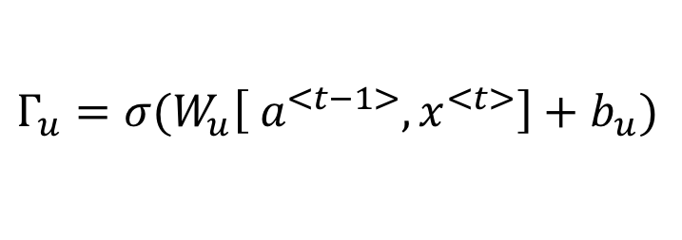
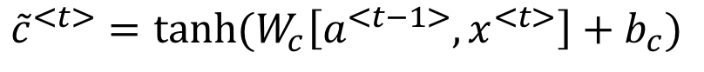
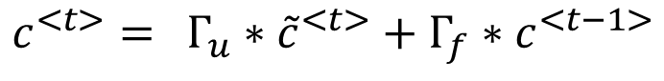
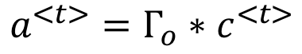
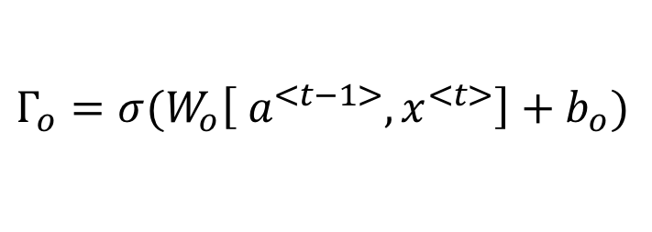
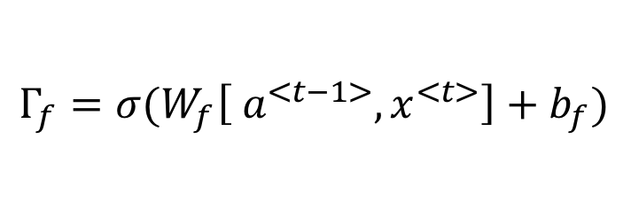
LSTM units
GRU
LSTM
$${\tilde{c}}^{<t>}=\tanh{(W_{c}\left[Γ_{r}∗c^{<t−1>},x^{<t>}\right]+b_{c})}$$
$${\tilde{c}}^{<t>}=\tanh{(W_{c}\left[a^{<t−1>},x^{<t>}\right]+b_{c})}$$
$$Γ_{u}=σ{(W_{u}\left[ c^{<t−1>},x^{<t>}\right]+b_{u})}$$
$$Γ_{u}=σ{(W_{u}\left[ a^{<t−1>},x^{<t>}\right]+b_{u})}$$
$$Γ_{r}=σ{(W_{r}\left[ c^{<t−1>},x^{<t>}\right]+b_{r})}$$
$$Γ_{f}=σ{(W_{f}\left[ a^{<t−1>},x^{<t>}\right]+b_{f})}$$
$$c^{<t>}=Γ_{u}{∗{\tilde{c}}^{<t>}+\left(1−Γ_{u}\right)∗c^{<t−1>}}$$
$$Γ_{o}=σ{(W_{o}\left[ a^{<t−1>},x^{<t>}\right]+b_{o})}$$
$$a^{<t>}=c^{<t>}$$
$$c^{<t>}={Γ_{u}∗{\tilde{c}}^{<t>}+Γ_{f}∗c^{<t−1>}}$$
$$a^{<t>}=Γ_{o}∗c^{<t>}$$
[Hochreiter & Schmidhuber 1997. Long short-term memory]

Slide 35
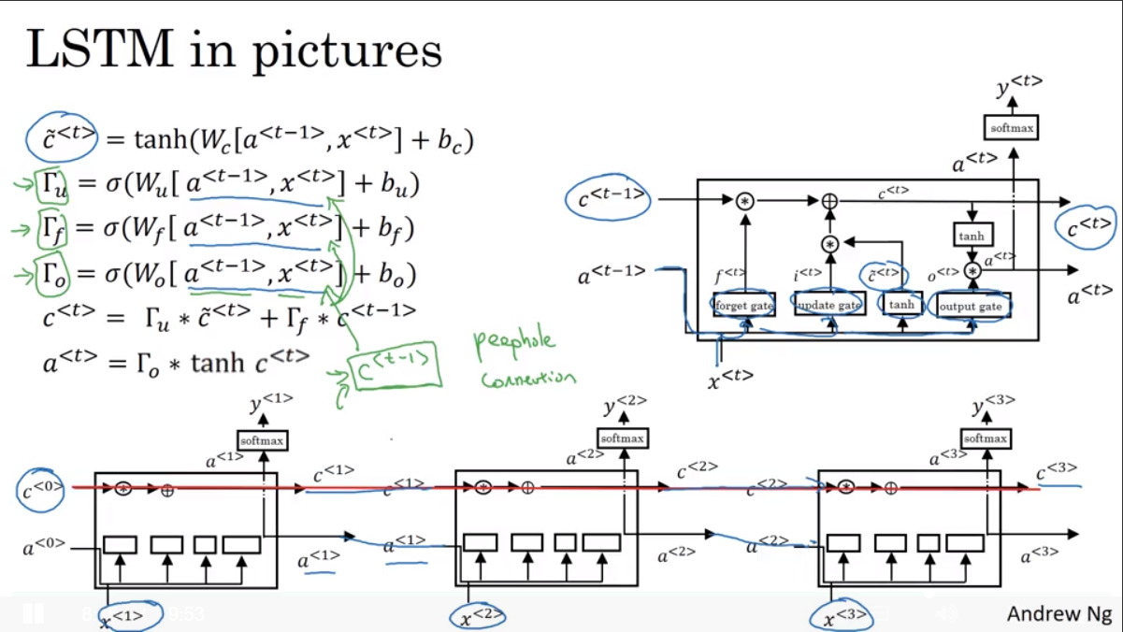

Slide 36
Recurrent Neural Networks
Bidirectional RNN
deeplearning.ai

Slide 37
Getting information from the future
He said, “Teddy bears are on sale!”
He said, “Teddy Roosevelt was a great President!”
$${\hat{y}}^{<1> }$$
$${\hat{y}}^{<2> }$$
$${\hat{y}}^{<3> }$$
$${\hat{y}}^{<4> }$$
$${\hat{y}}^{<5> }$$
$${\hat{y}}^{<6> }$$
$${\hat{y}}^{<7> }$$
$$a^{<0>}$$
$$a^{<1>}$$
$$a^{<2>}$$
$$a^{<3>}$$
$$a^{<4>}$$
$$a^{<5>}$$
$$a^{<6>}$$
$$a^{<7>}$$
$$x^{<1>}$$
$$x^{<2>}$$
$$x^{<3>}$$
$$x^{<4>}$$
$$x^{<5>}$$
$$x^{<6>}$$
$$x^{<7>}$$
He said, “Teddy bears are on sale!”

Slide 38
Bidirectional RNN (BRNN)

Slide 39
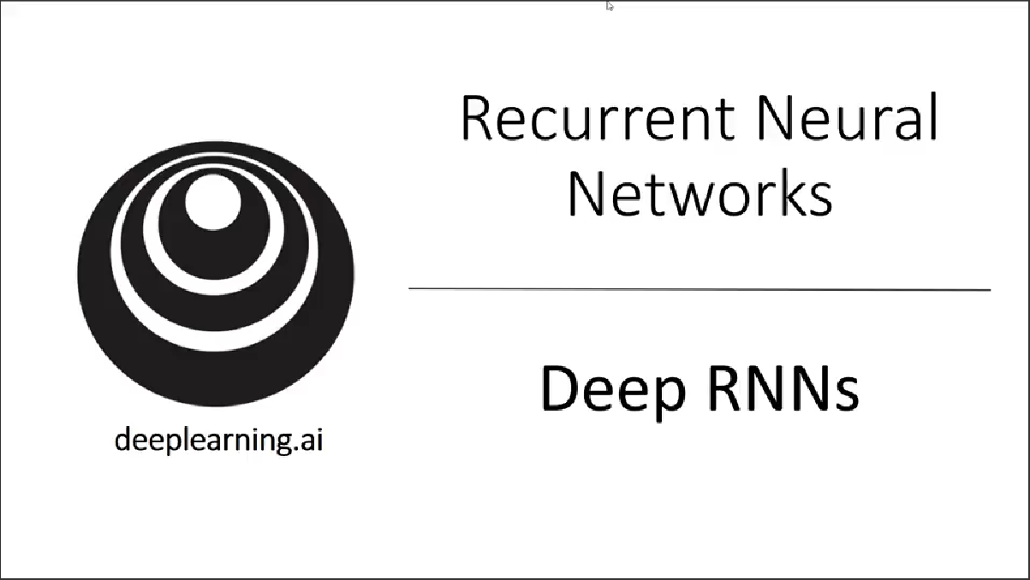

Slide 40
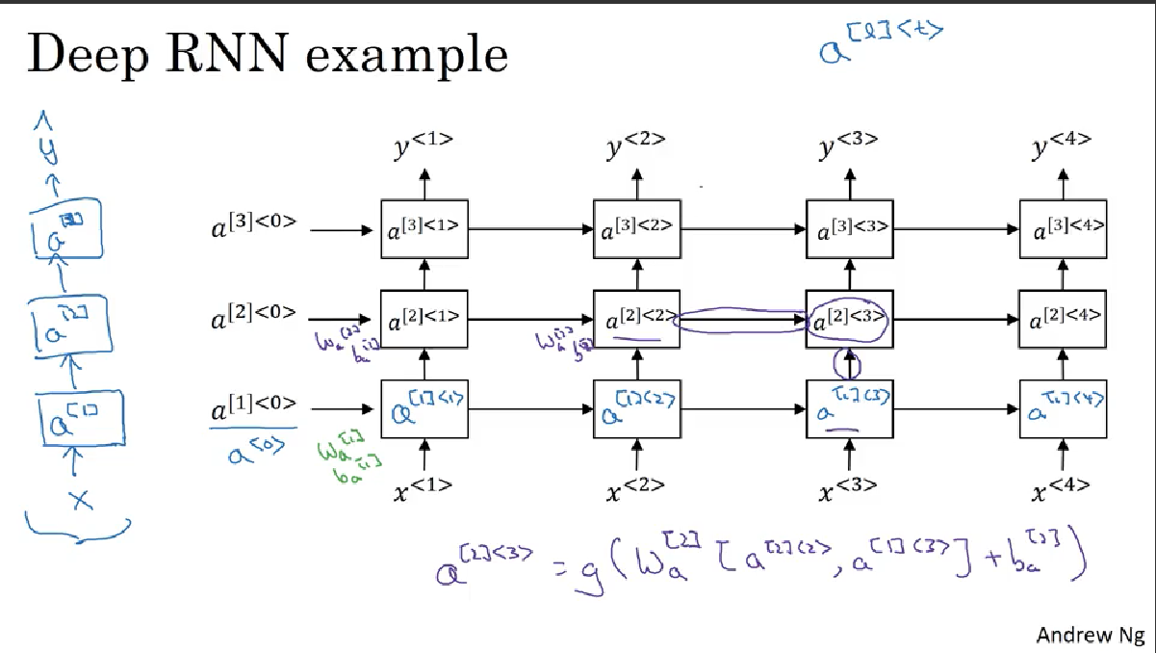

Slide 41
